Slide 1
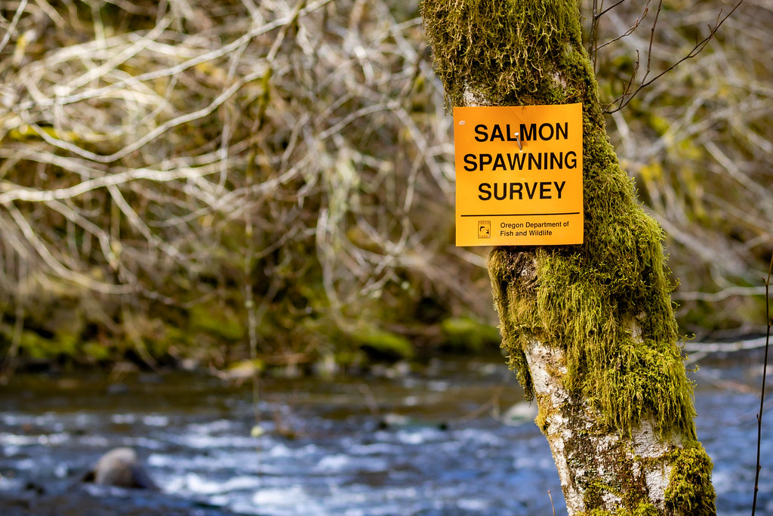
Evaluating Salmonid Survey Methods for Precision and Bias Brian McGreal – FISH 550

Slide 2
Background

Slide 3
Why salmon are important?

Slide 4
Why salmon are important?
Ecologically crucial species

Slide 5
Why salmon are important?
Ecologically crucial species
Marine nutrients found in trees in central Idaho

Slide 6
Why salmon are important?
Ecologically crucial species
Marine nutrients found in trees in central Idaho
Cultural significance

Slide 7
Why salmon are important?
Ecologically crucial species
Marine nutrients found in trees in central Idaho
Cultural significance
Central to Indigenous ways of life and cultural identity

Slide 8
Why salmon are important?
Ecologically crucial species
Marine nutrients found in trees in central Idaho
Cultural significance
Central to Indigenous ways of life and cultural identity
Commercial significance

Slide 9
Why salmon are important?
Ecologically crucial species
Marine nutrients found in trees in central Idaho
Cultural significance
Central to Indigenous ways of life and cultural identity
Commercial significance
$5.2 million in OR in 2023

Slide 10
How are salmon doing?

Slide 11
How are salmon doing?
Not great in the lower 48

Slide 12
How are salmon doing?
Not great in the lower 48
28 population groups of salmon listed as endangered or threatened under ESA

Slide 13
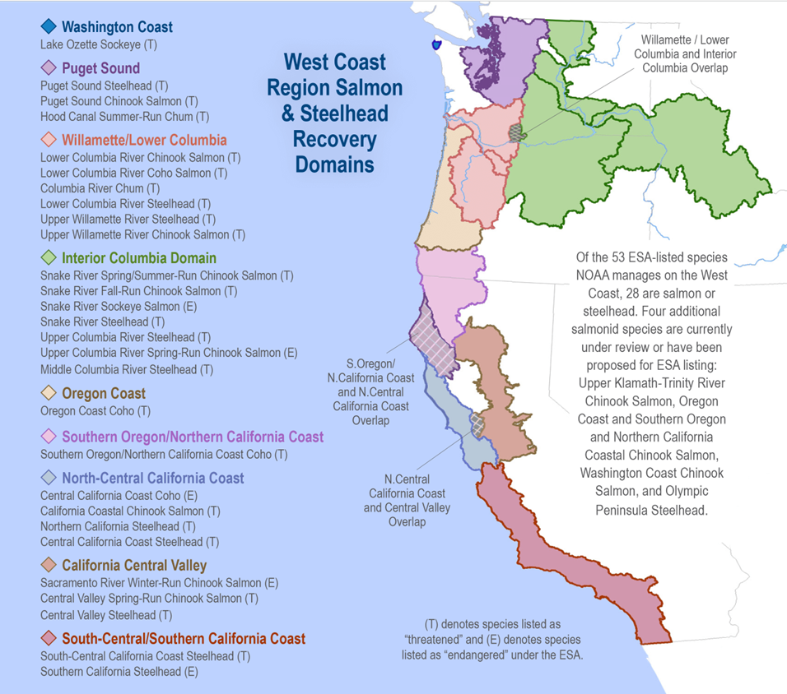

Slide 14
How are salmon doing?
Not great in the lower 48
28 population groups of salmon listed as endangered or threatened under ESA
13 of these in Columbia Basin

Slide 15
How are salmon doing?
Not great in the lower 48
28 population groups of salmon listed as endangered or threatened under ESA
13 of these in Columbia Basin
Despite restoration efforts

Slide 16
How are salmon doing?
Not great in the lower 48
28 population groups of salmon listed as endangered or threatened under ESA
13 of these in Columbia Basin
Despite restoration efforts
$ 9 billion spent in Columbia Basin since 1990s

Slide 17
How are salmon doing?
Not great in the lower 48
28 population groups of salmon listed as endangered or threatened under ESA
13 of these in Columbia Basin
Despite restoration efforts
$ 9 billion spent in Columbia Basin since 1990s
(Jaeger & Scheuerell 2023)

Slide 18
How do we know how salmon are doing?

Slide 19
How do we know how salmon are doing?
We count them!

Slide 20
How do we know how salmon are doing?
We count them!
Well, we count some of them and make educated guesses about the rest…

Slide 21
How do we know how salmon are doing?
We count them!
Well, we count some of them and make educated guesses about the rest…
Using a variety of survey methods and monitoring techniques

Slide 22
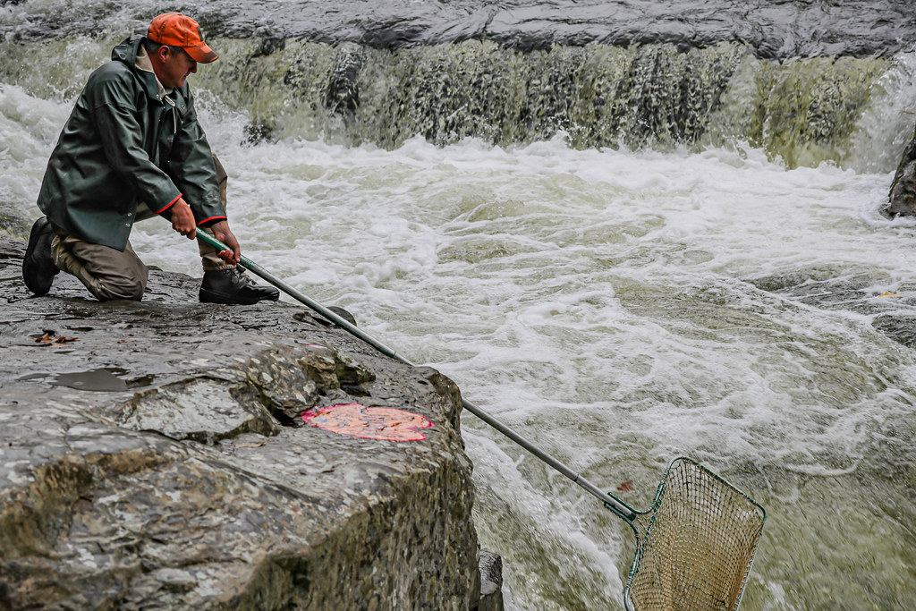
How do we know how salmon are doing?

Slide 23
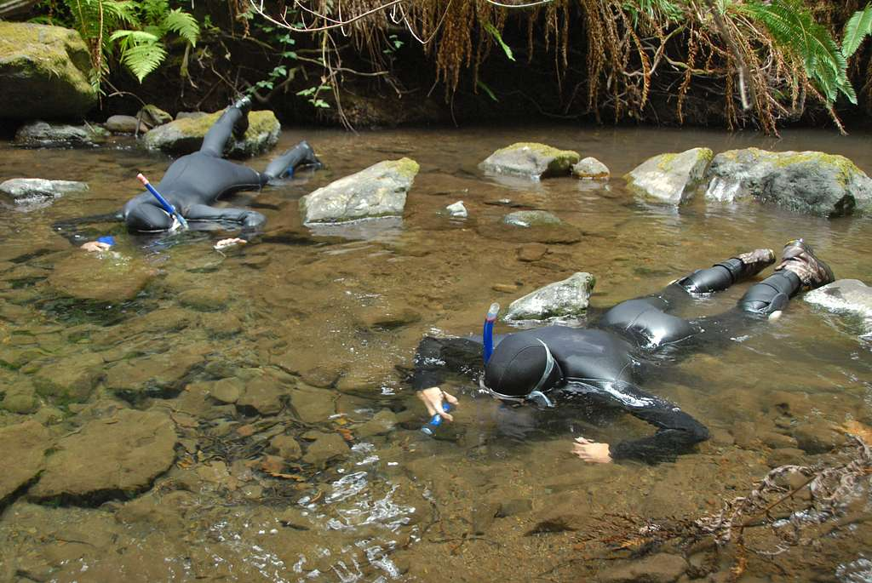
How do we know how salmon are doing?

Slide 24
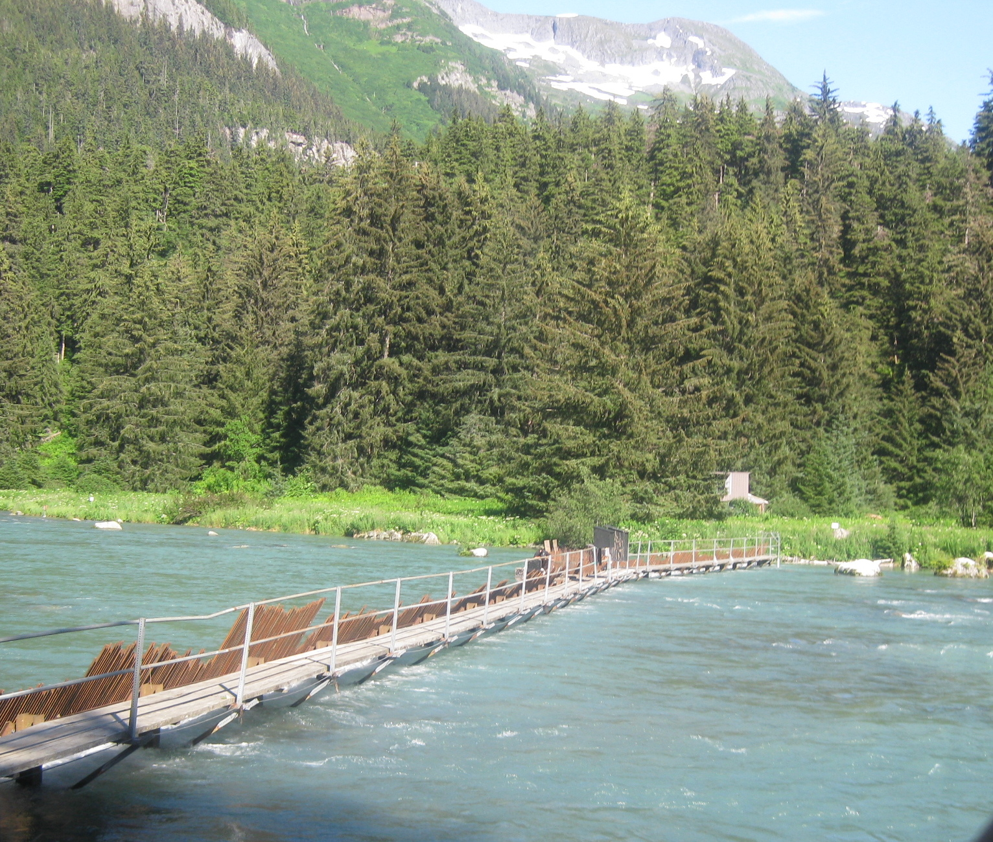
How do we know how salmon are doing?

Slide 25
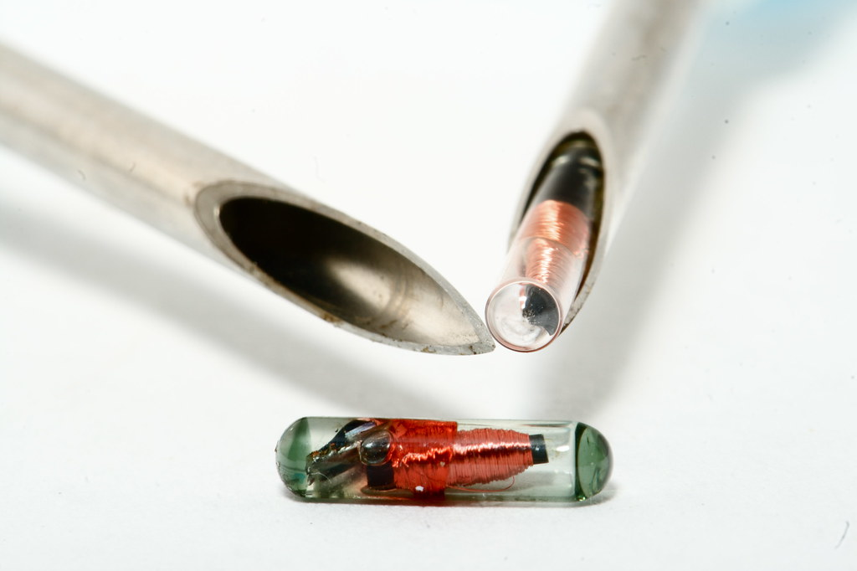
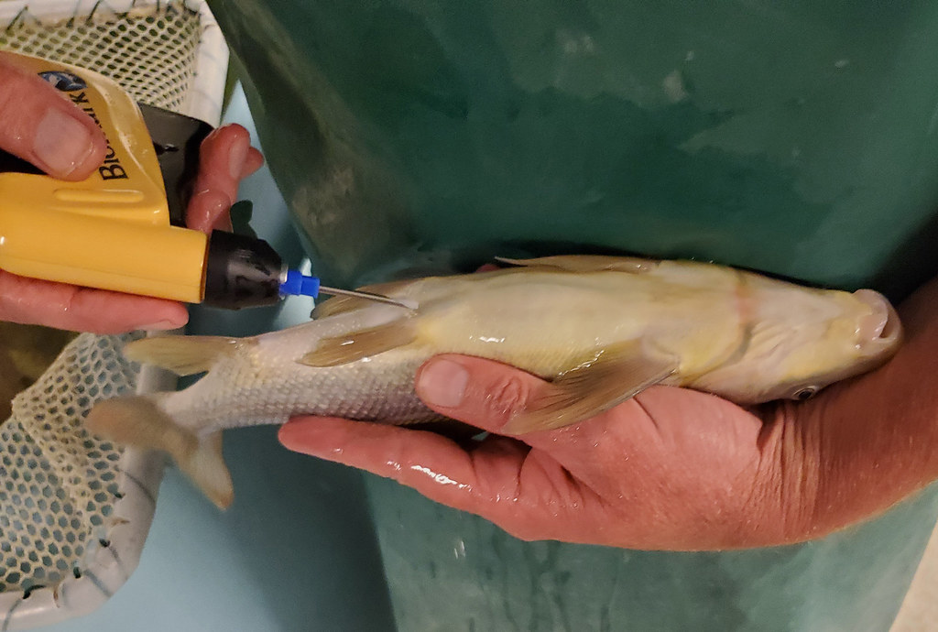
How do we know how salmon are doing?

Slide 26
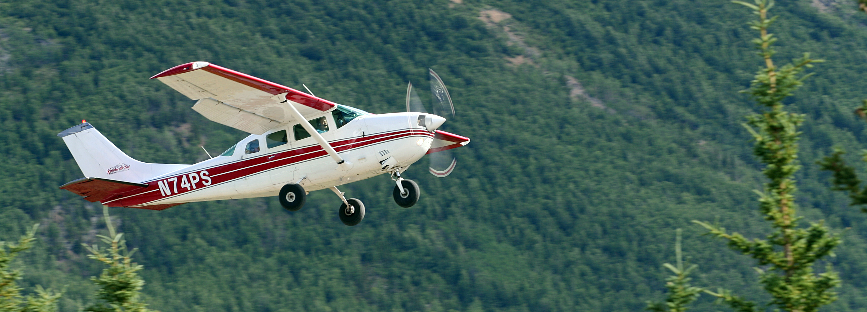
How do we know how salmon are doing?

Slide 27
How do we know how salmon are doing?

Slide 28
Research goal: Evaluate salmon survey methods for precision and directional bias

Slide 29
Data

Slide 30
Data
Spawning salmon estimates in Oregon
3 species: Chinook, coho, steelhead
68 populations
Annual observations, 1980 to 2022
31 survey methods

Slide 31
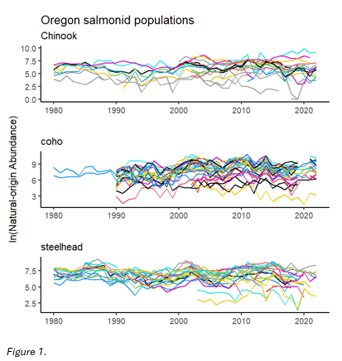
Data – abundance estimates

Slide 32
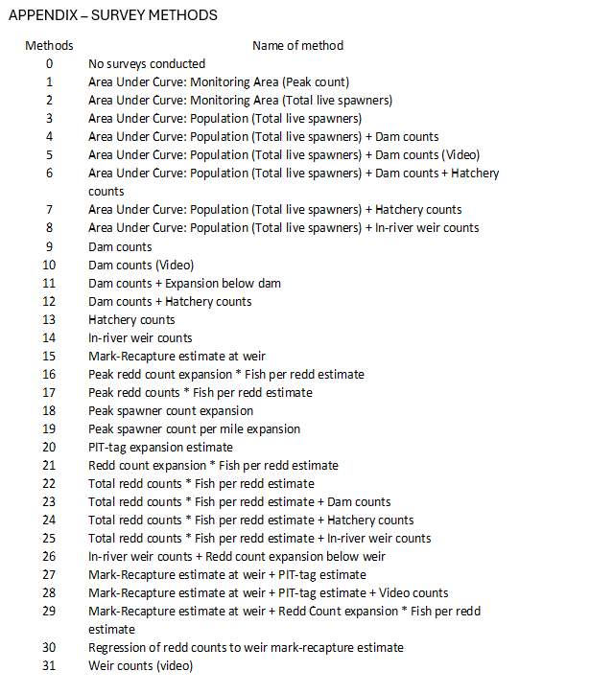
Data – survey methods

Slide 33
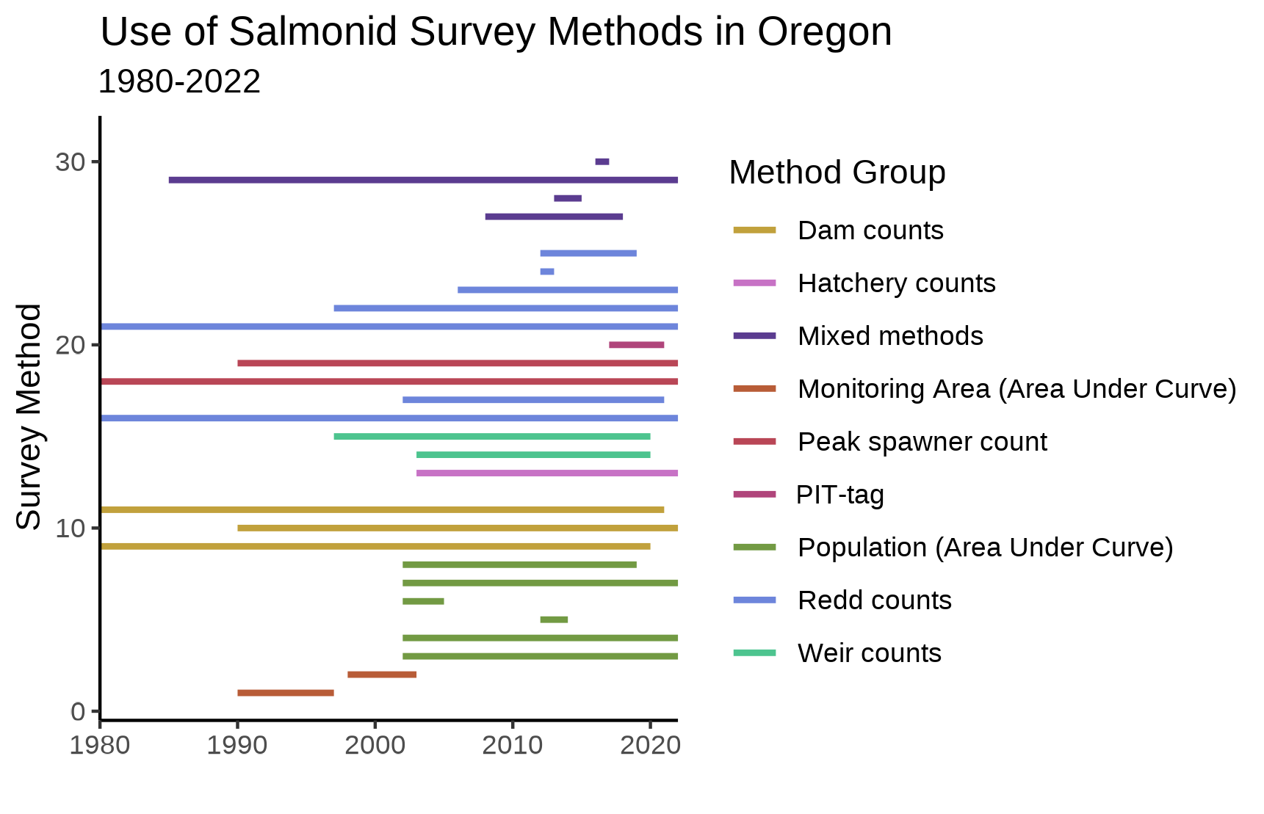
Data – survey methods

Slide 34
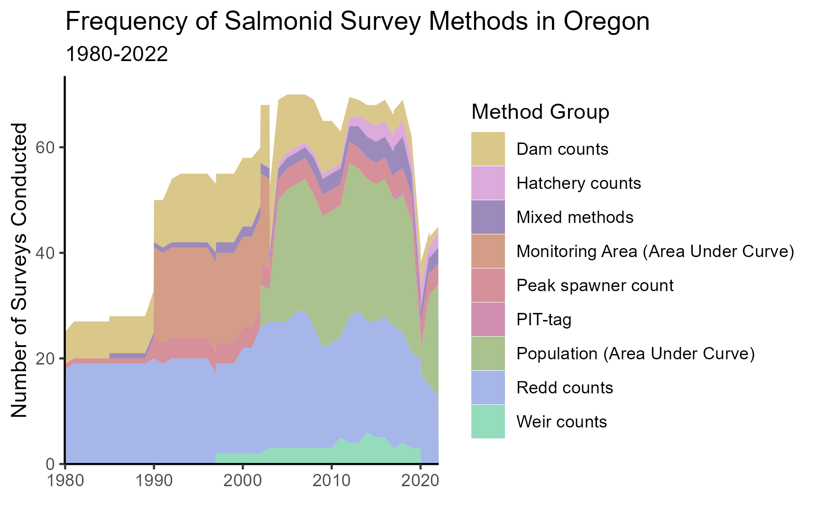
Data – survey methods

Slide 35
Methods

Slide 36
Modeling approach
MARSS models!
x_{t} = Bx_{t−1} + u + w_{t}, where w_{t}∼MVN(0,Q)
y_{t} = Zx_{t} + a + v_{t}, where v_{t}∼MVN(0,R)

Slide 37
Modeling approach
MARSS models!
x_{t} = Bx_{t−1} + u + w_{t}, where w_{t}∼MVN(0,Q)
y_{t} = Zx_{t} + a + v_{t}, where v_{t}∼MVN(0,R)
(does anyone remember these from class?)

Slide 38
Modeling approach
What am I concerned with?
x_{t} = Bx_{t−1} + u + w_{t}, where w_{t}∼MVN(0,Q)
y_{t} = Zx_{t} + a + v_{t}, where v_{t}∼MVN(0,R)

Slide 39
Modeling approach
What am I concerned with?
x_{t} = Bx_{t−1} + u + w_{t}, where w_{t}∼MVN(0,Q)
y_{t} = Zx_{t} + a + v_{t}, where v_{t}∼MVN(0,R)
I am interested in observation bias (a) and observation variance (R)

Slide 40
Modeling approach
Specifying matrices properly is crucial
x_{t} = Bx_{t−1} + u + w_{t}, where w_{t}∼MVN(0,Q)
y_{t} = Zx_{t} + a + v_{t}, where v_{t}∼MVN(0,R)
I am interested in observation bias (a) and observation variance (R)

Slide 41
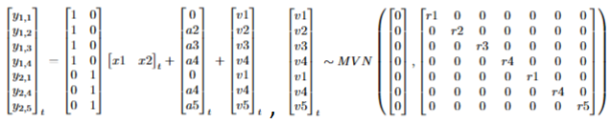
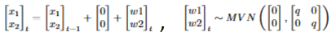
Modeling approach
Specifying matrices properly is crucial

Slide 42
Modeling approach
Specifying matrices properly is crucial
A reference method must be chosen to estimate bias

Slide 43
Results

Slide 44
Results
Precision (R) and bias (a) terms estimated for 19 survey methods

Slide 45
Results
Precision (R) and bias (a) terms estimated for 19 survey methods
Not every method evaluated for every species

Slide 46
Results
Precision (R) and bias (a) terms estimated for 19 survey methods
Not every method evaluated for every species
12 methods with very few data points in the time series

Slide 47
Results
Precision (R) and bias (a) terms estimated for 19 survey methods
Not every method evaluated for every species
12 methods with very few data points in the time series

Slide 48
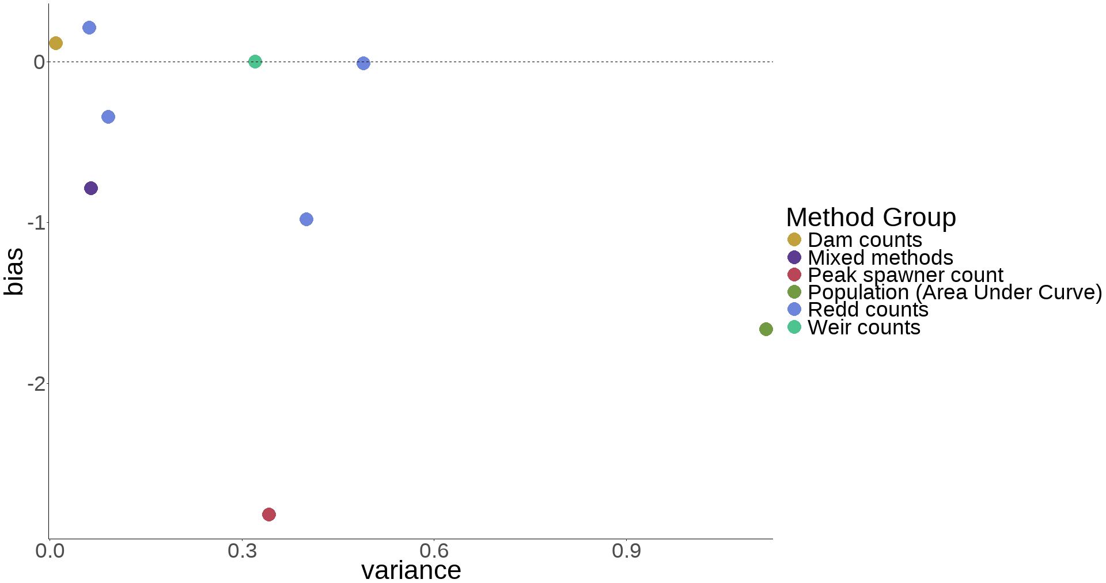
Results - Chinook
Reference method: Mark-recapture estimate at weir, a=0

Slide 49
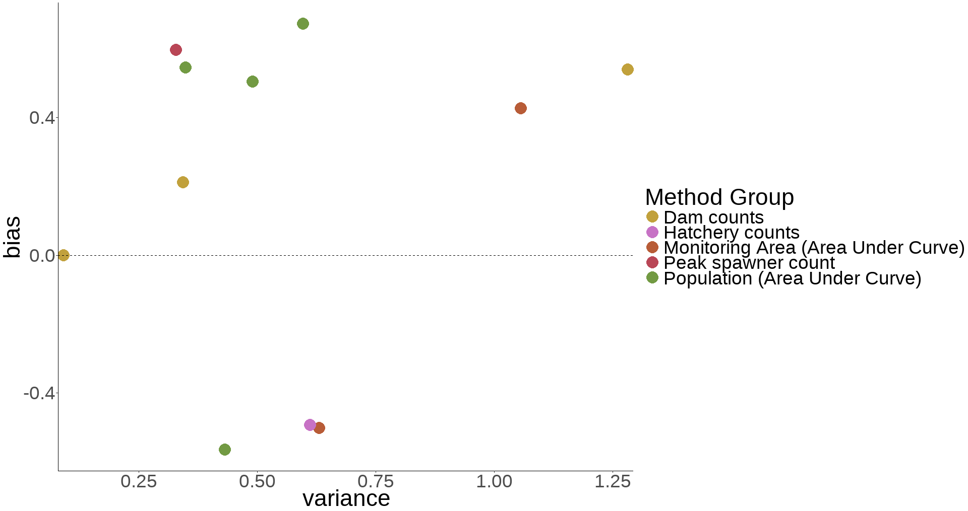
Results - coho
Reference method: Dam counts (video), a=0

Slide 50
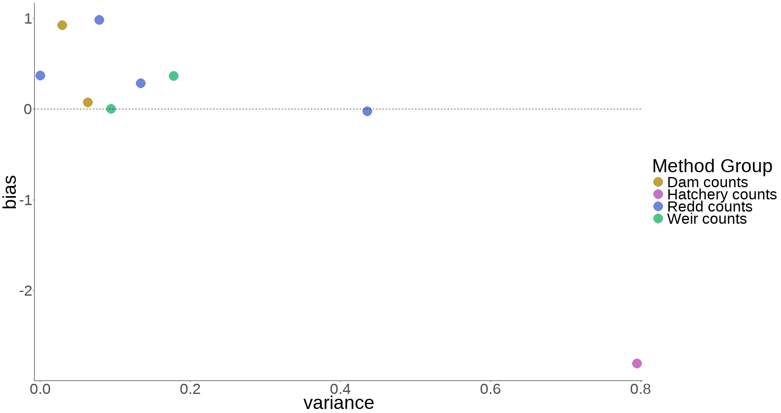
Results - steelhead
Reference method: In-river weir count, a=0

Slide 51
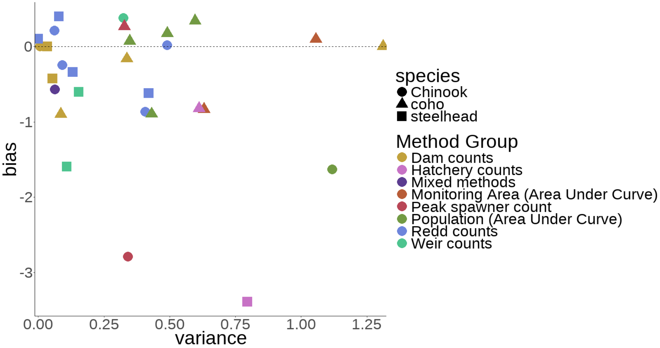
Results – all species
Reference method: Dam counts + Expansion below dam, a=0

Slide 52
Results
The same survey method can have very different levels of precision between species

Slide 53
Results
The same survey method can have very different levels of precision between species
AUC population estimates and peak spawner counts tend to be at extremes in terms of bias

Slide 54
Results
Coho generally seem to be more difficult to count precisely than Chinook or steelhead

Slide 55
Results
Coho generally seem to be more difficult to count precisely than Chinook or steelhead
Dam counts, weir counts, and redd counts tend to be most precise

Slide 56
Discussion & Next Steps

Slide 57
Discussion
Wide variety of survey methods available to biologists

Slide 58
Discussion
Wide variety of survey methods available to biologists
Understanding bias and precision is crucial

Slide 59
Discussion
Wide variety of survey methods available to biologists
Understanding bias and precision is crucial
Decisions such as ESA listing are dependent on accurate estimates

Slide 60
Next Steps
Evaluate cost of survey methods
Value of information

Slide 61
Next Steps
Evaluate cost of survey methods
Value of information
Additional data to compare estimates?
Could similar data be available from Washington

Slide 62
Next Steps
Evaluate cost of survey methods
Value of information
Additional data to compare estimates?
Could similar data be available from Washington
Effect of location
Could stream geomorphology impact survey accuracy?

Slide 63
Evaluating Salmonid Survey Methods for Precision and Bias Brian McGreal – FISH 550

